Slide 1
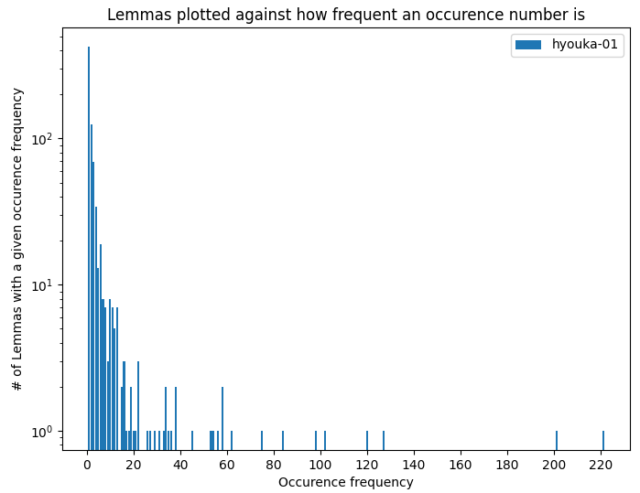
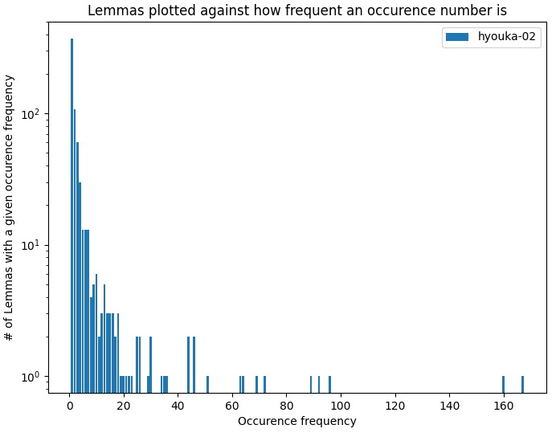


Lemma frequency for single episodes

Slide 2
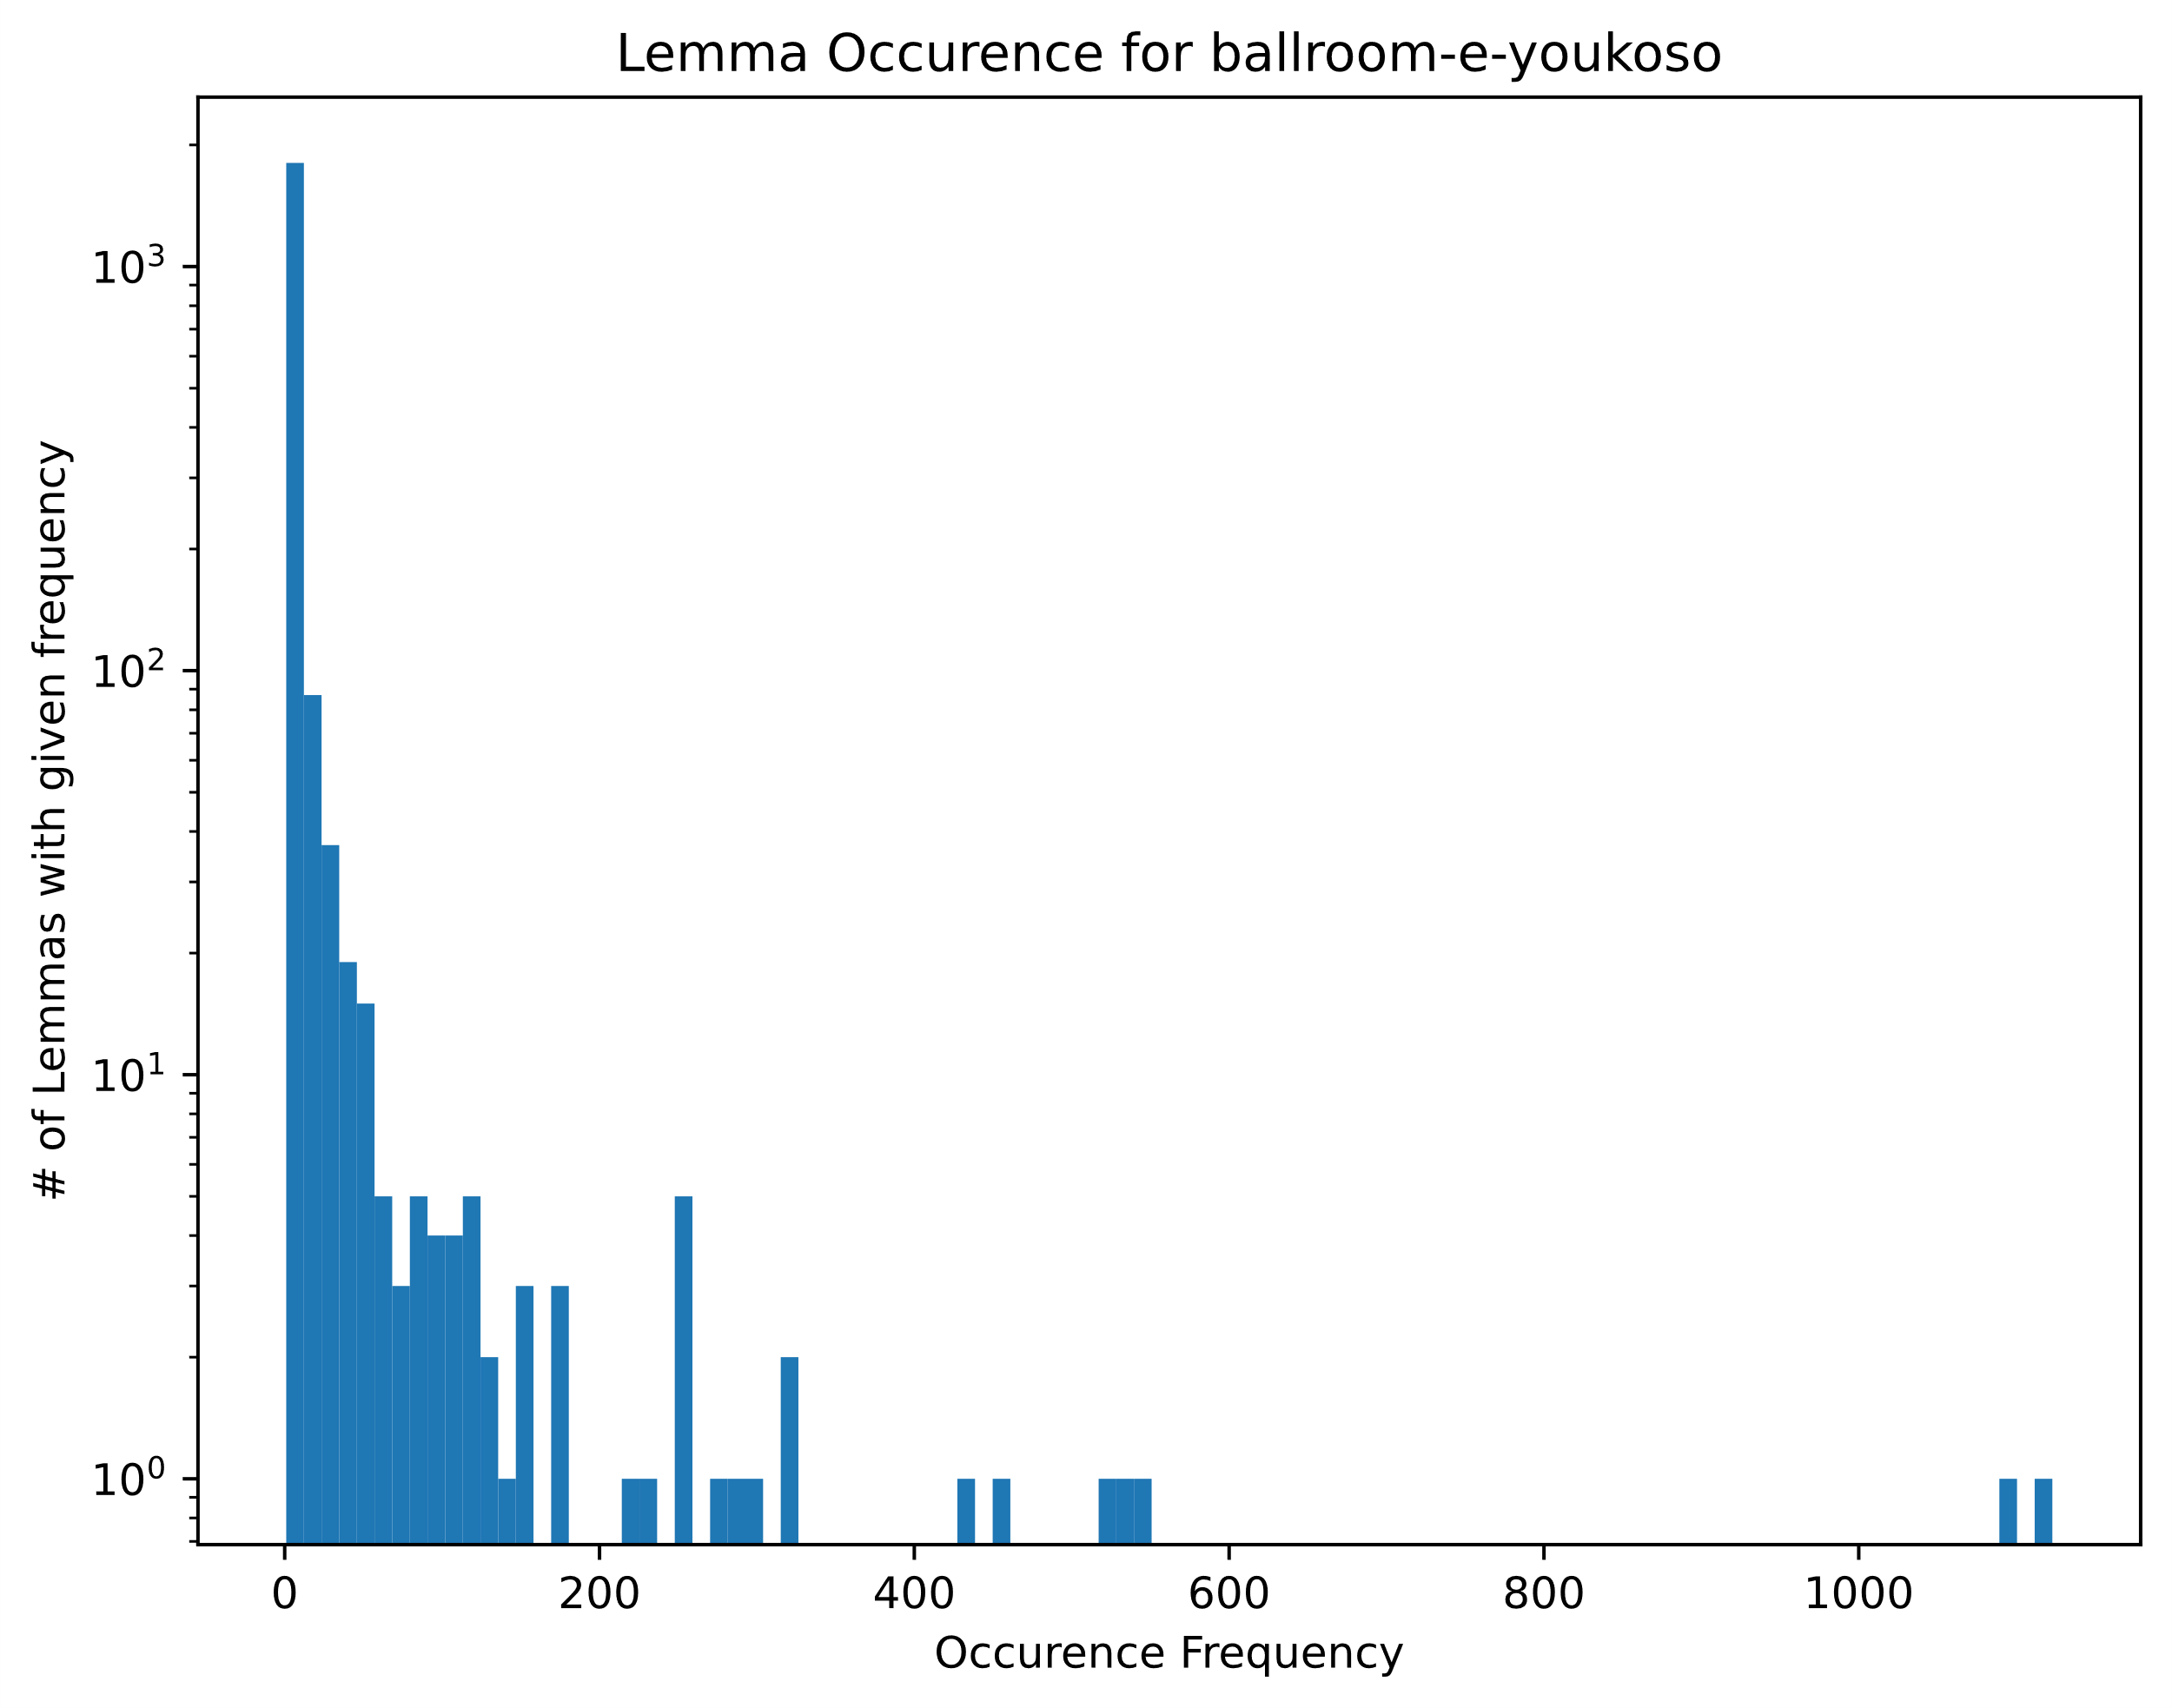
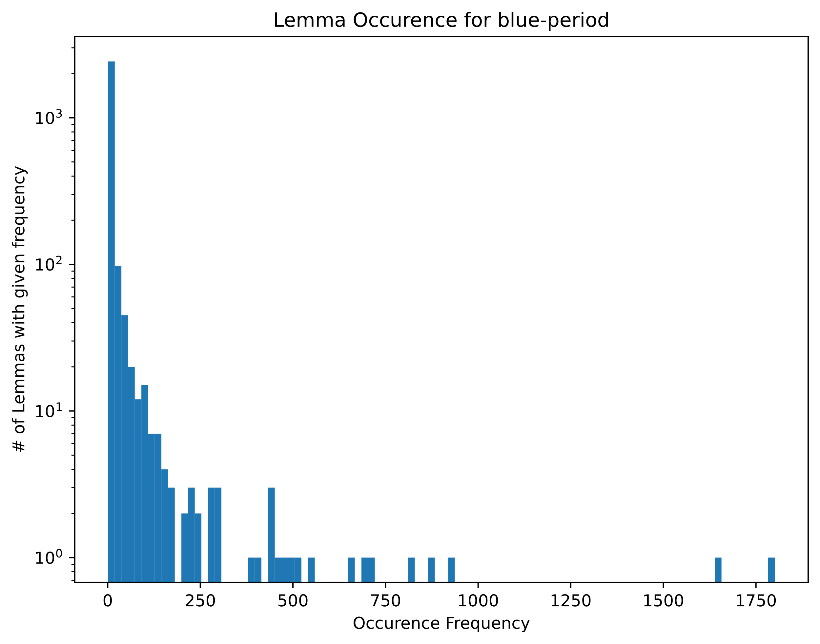
Lemma frequency for whole series

Slide 3
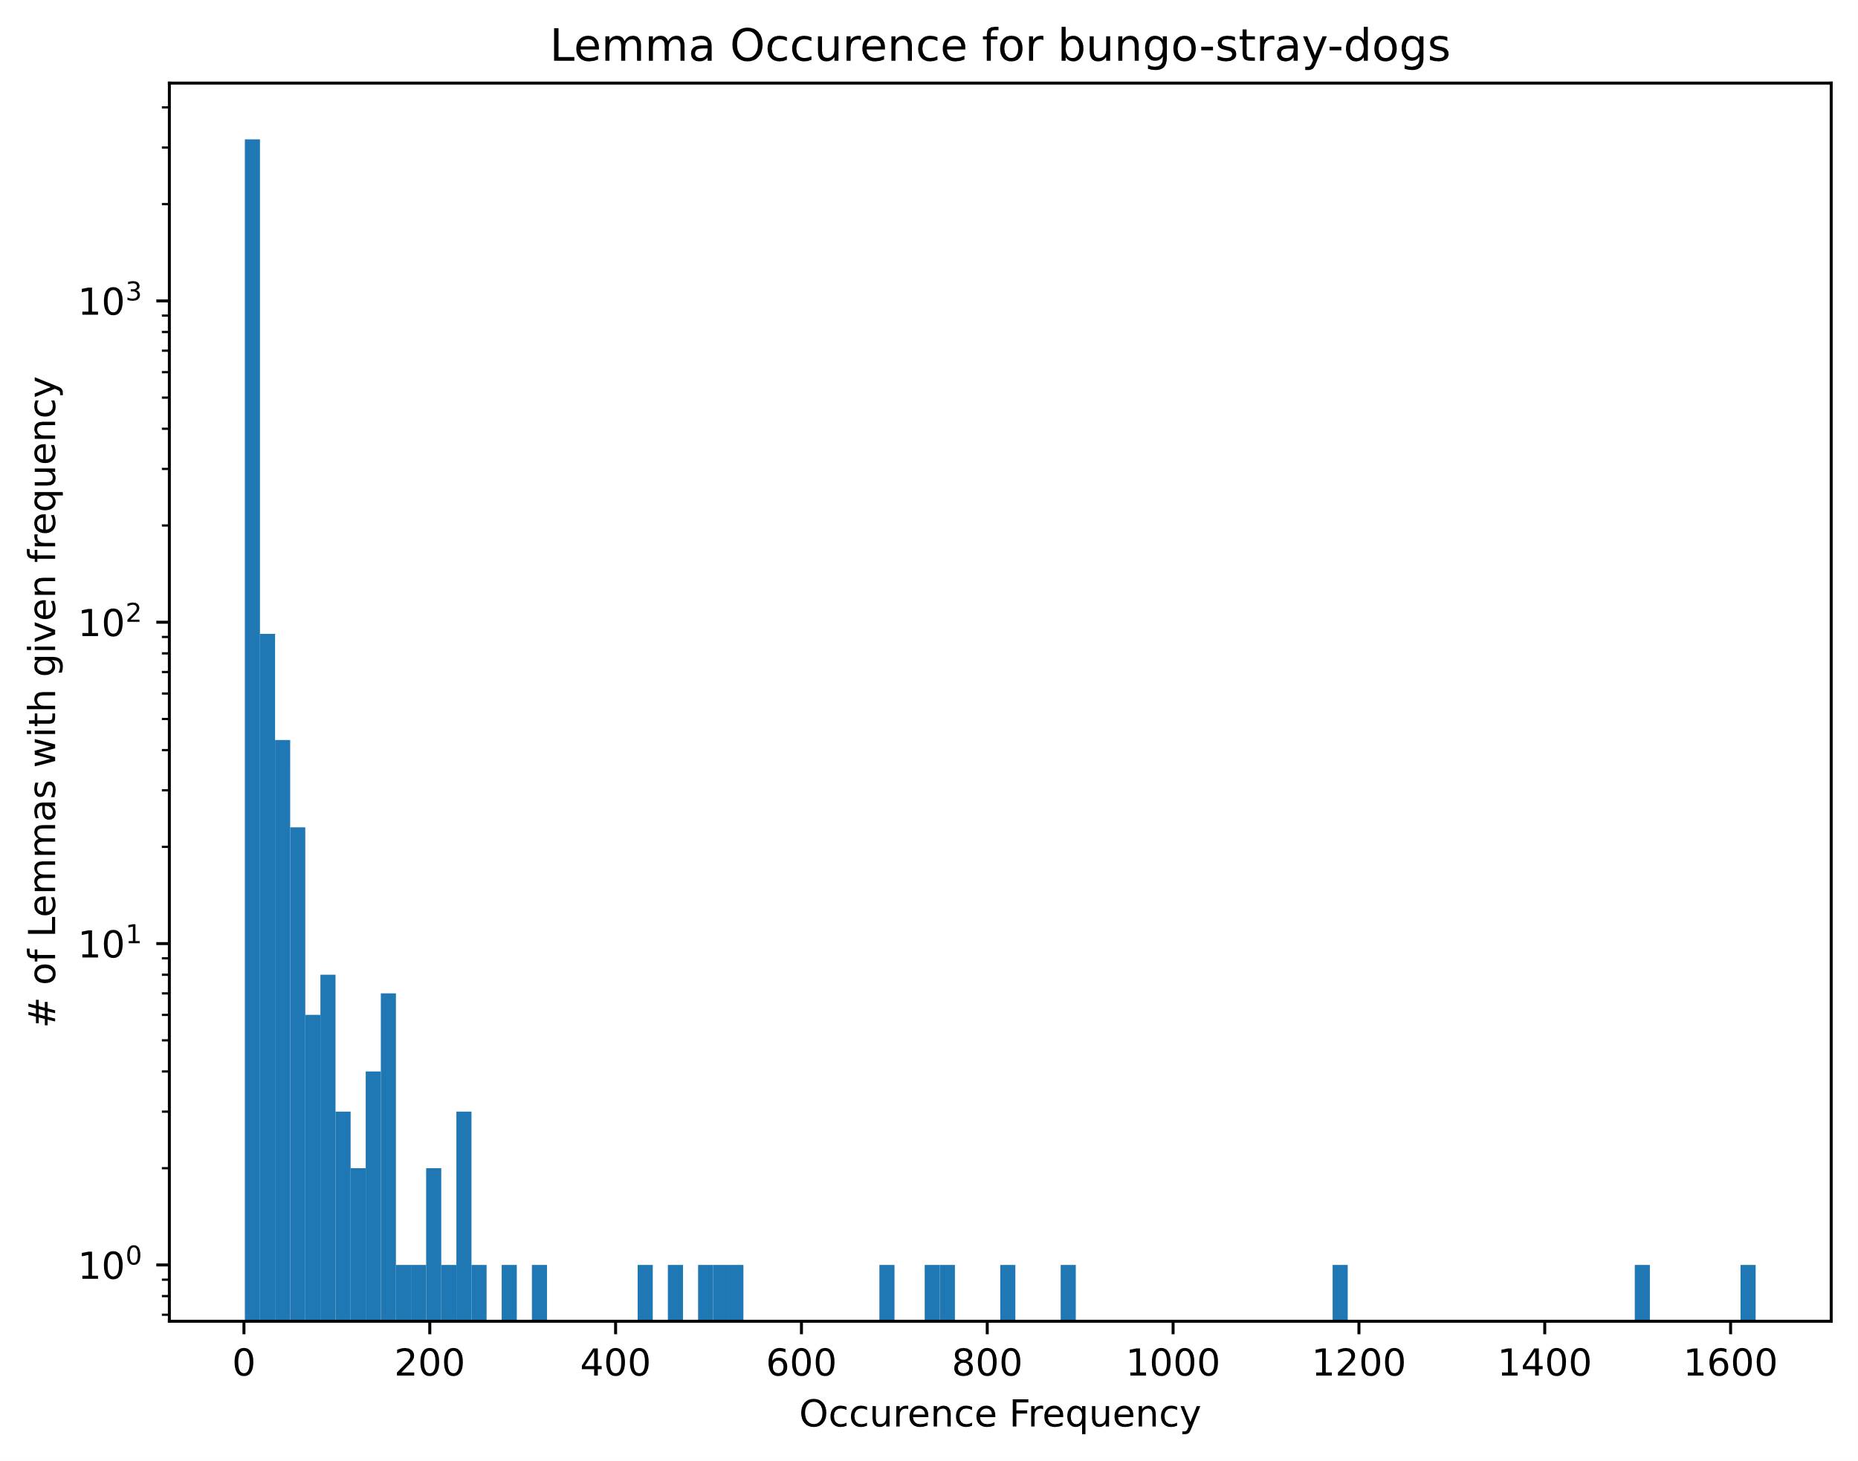
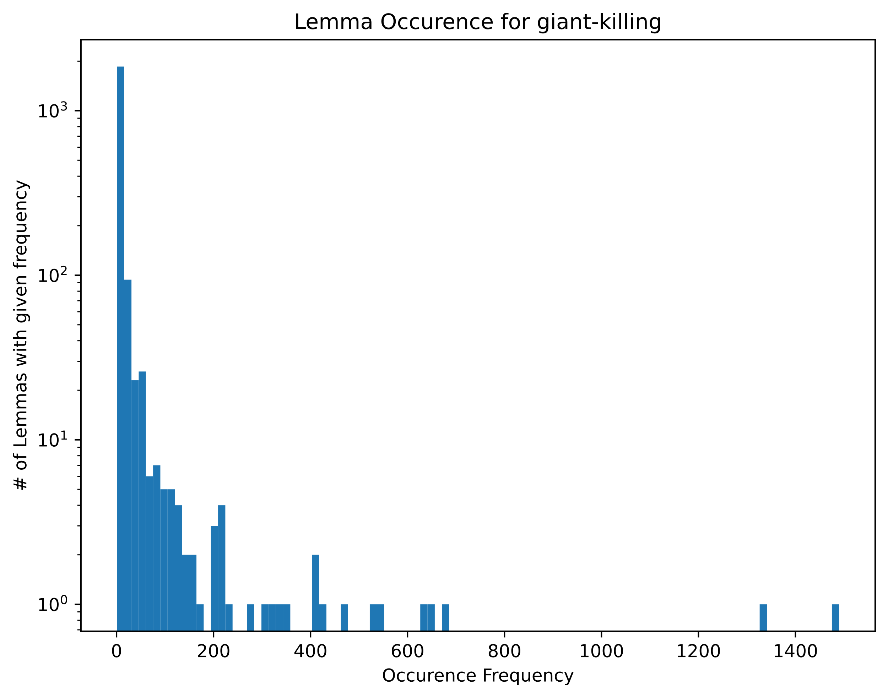

Slide 4



Slide 5
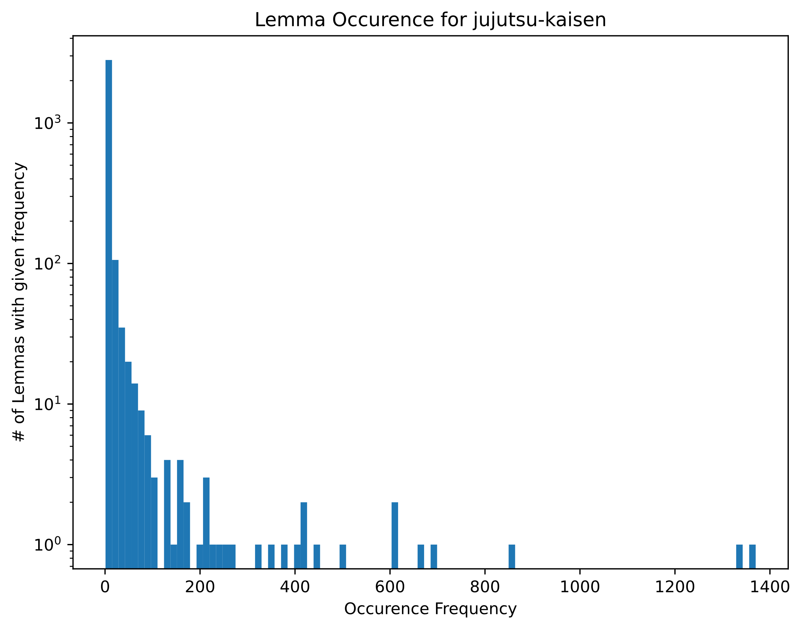
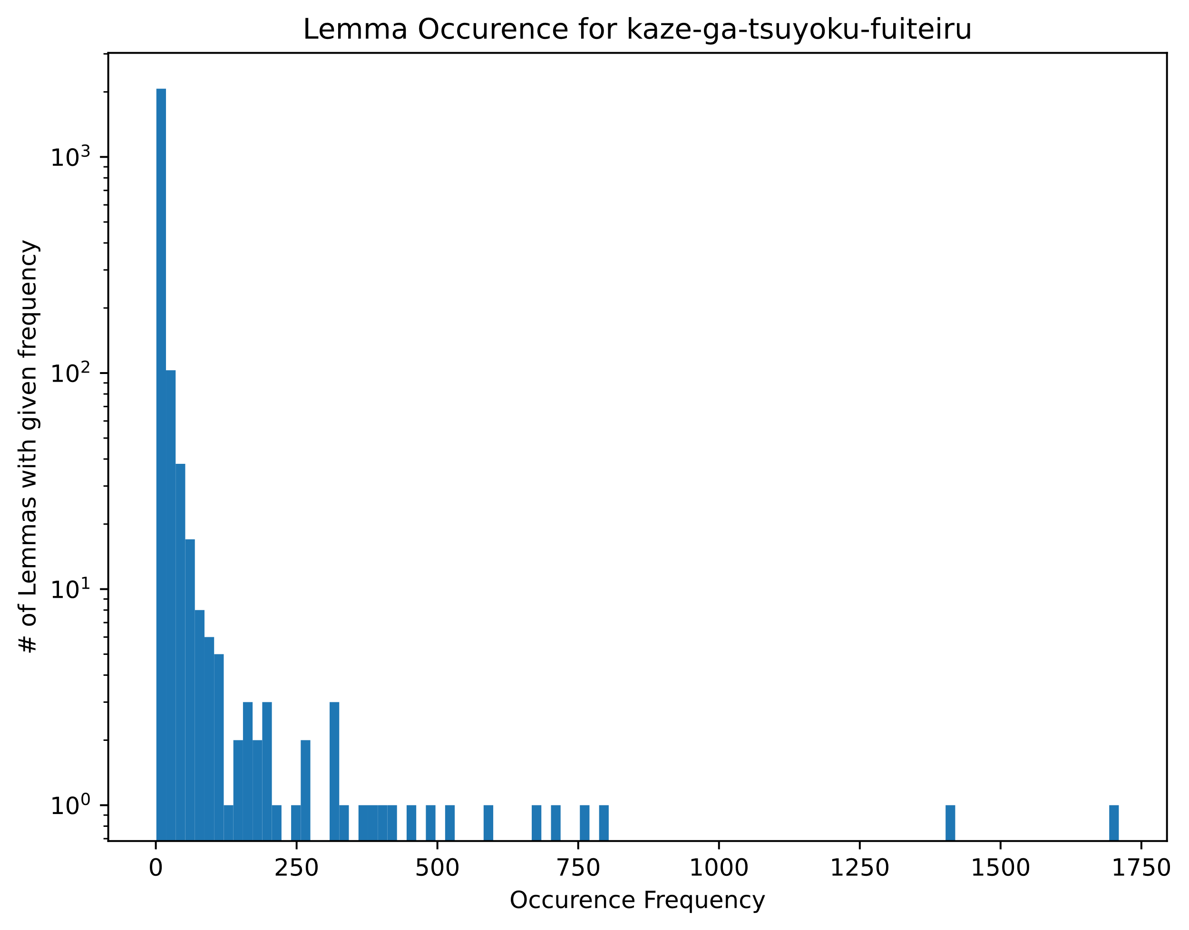

Slide 6

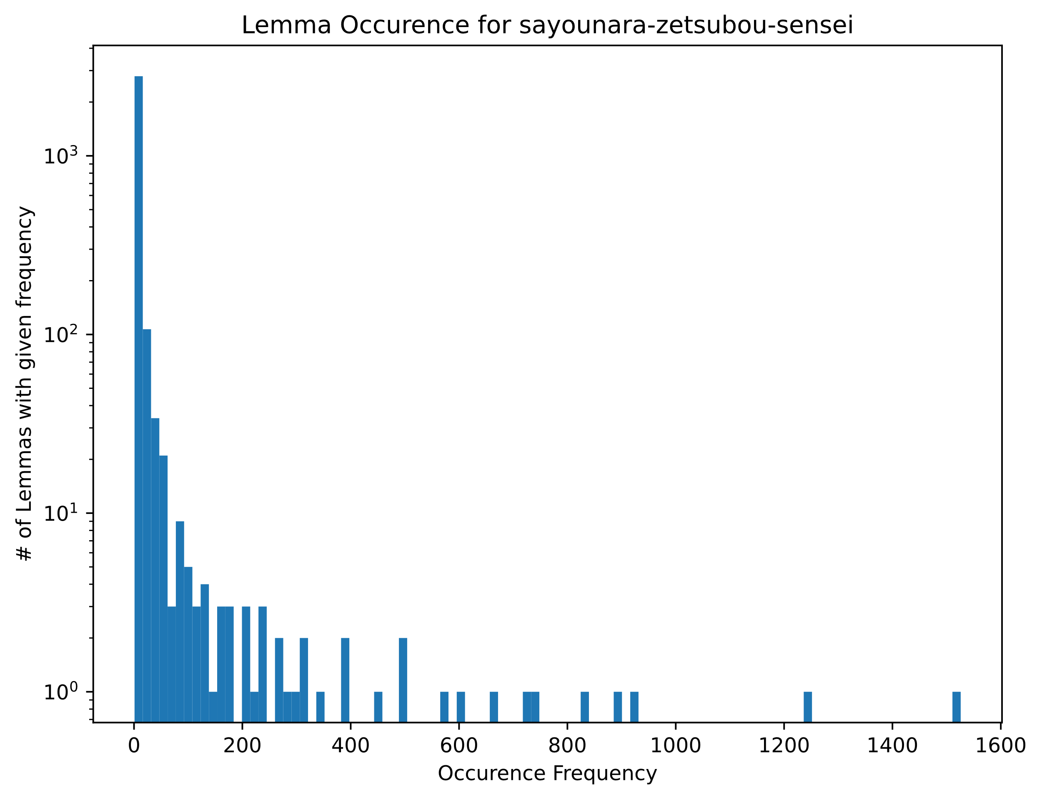

Slide 7


Slide 8
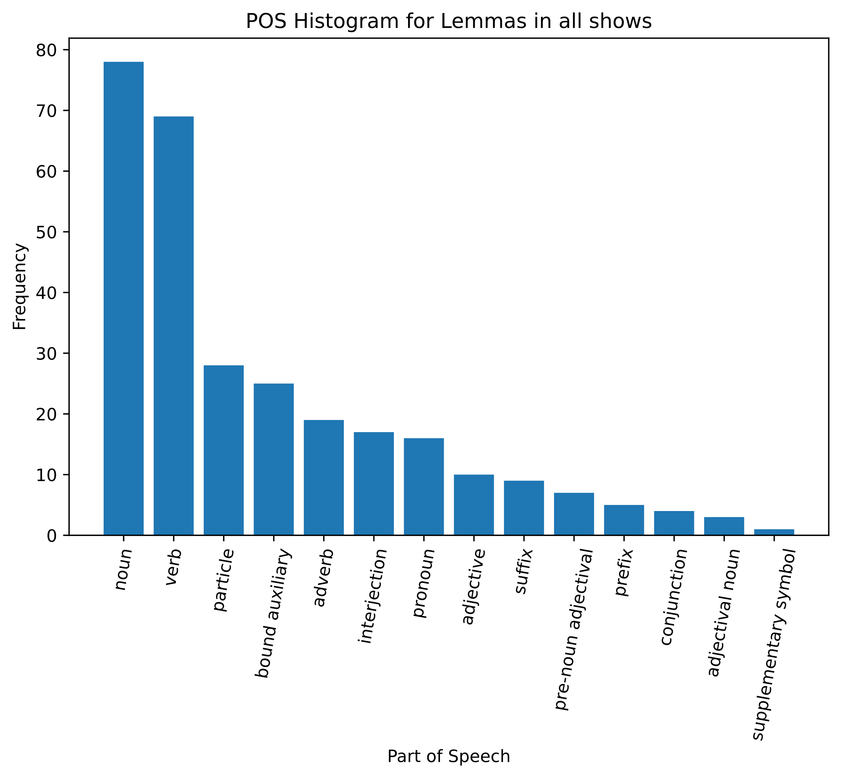
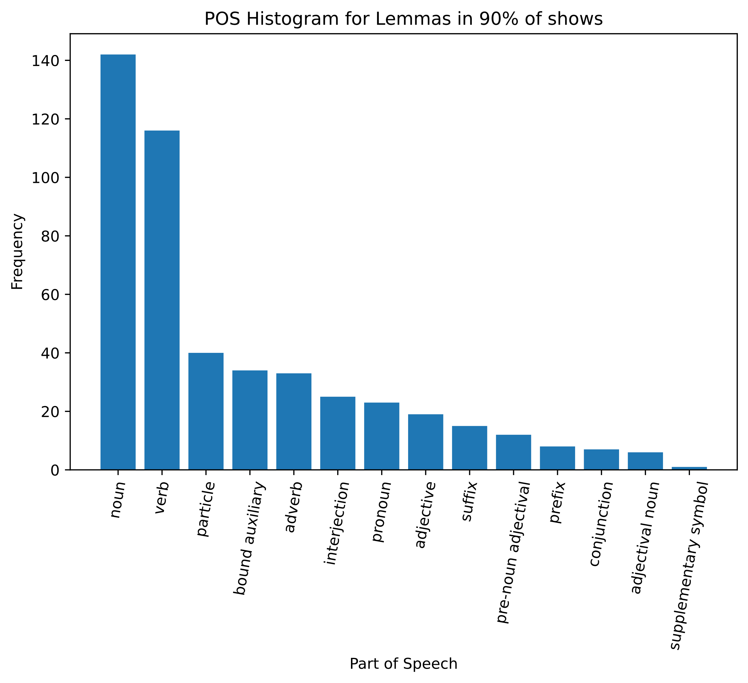
Parts of speech for lemmas present in all, 90%, and 80% of all the shows in the library

Slide 9
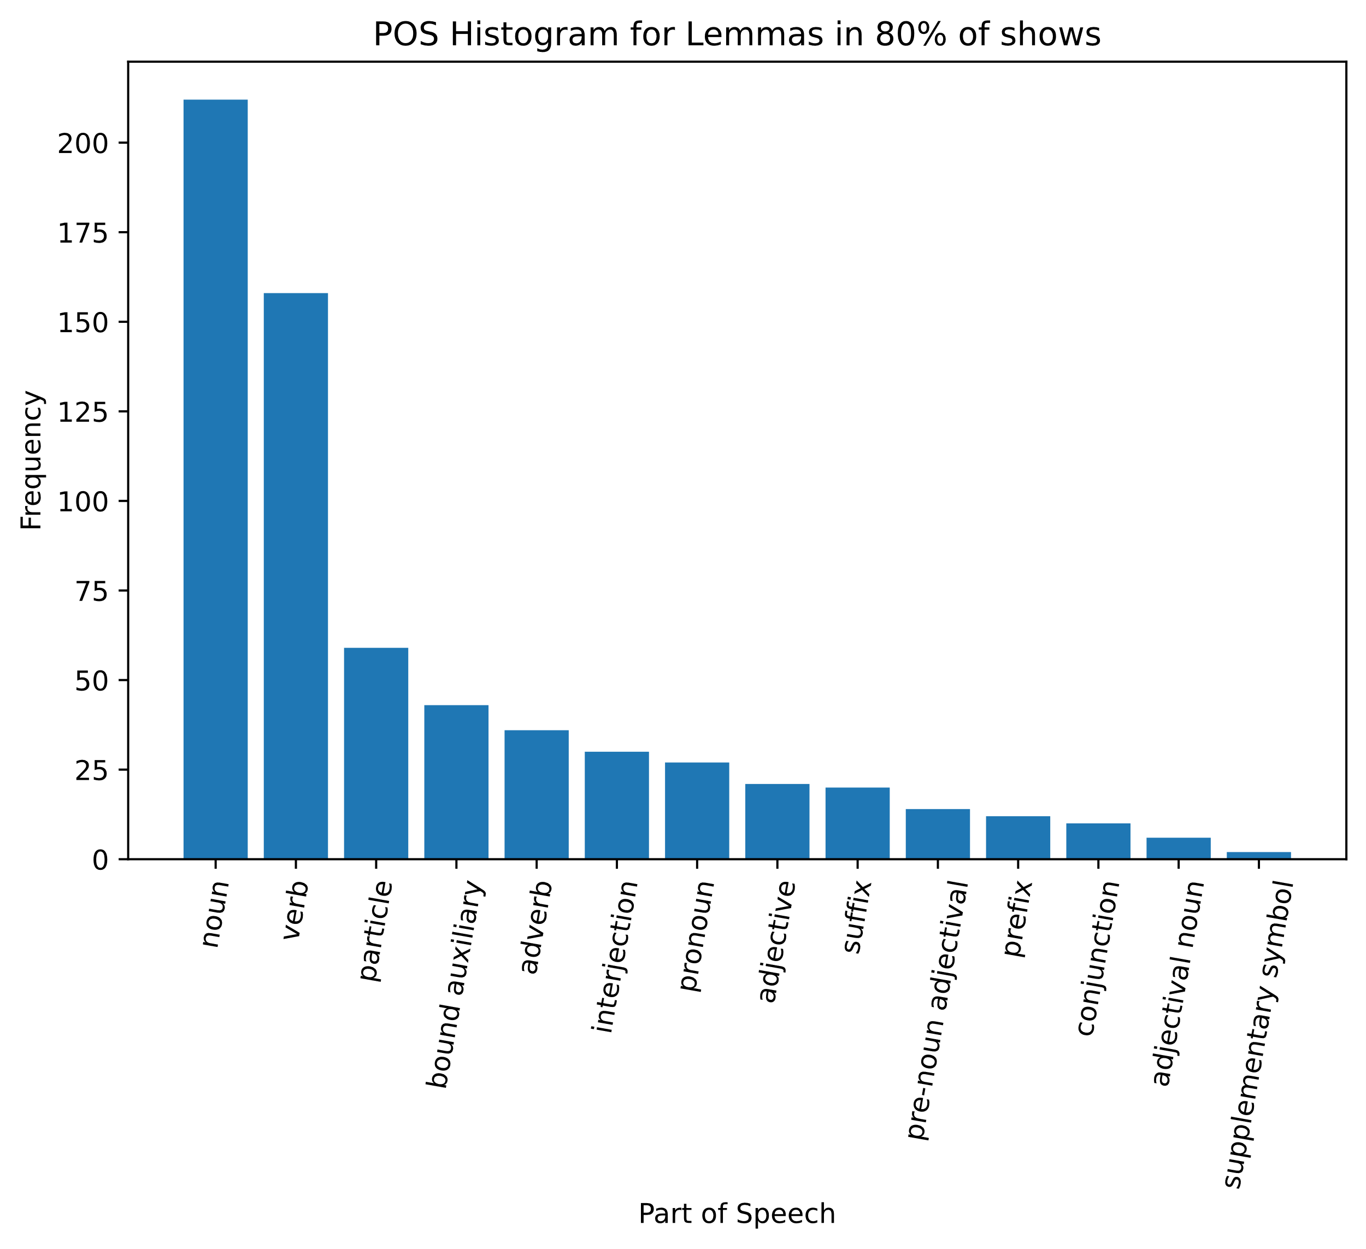
Parts of speech for lemmas present in all, 90%, and 80% of all the shows in the library

Slide 10
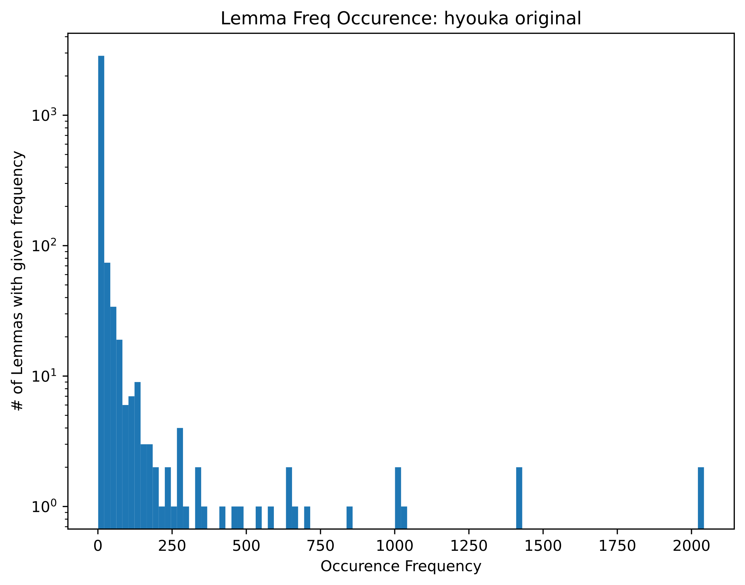
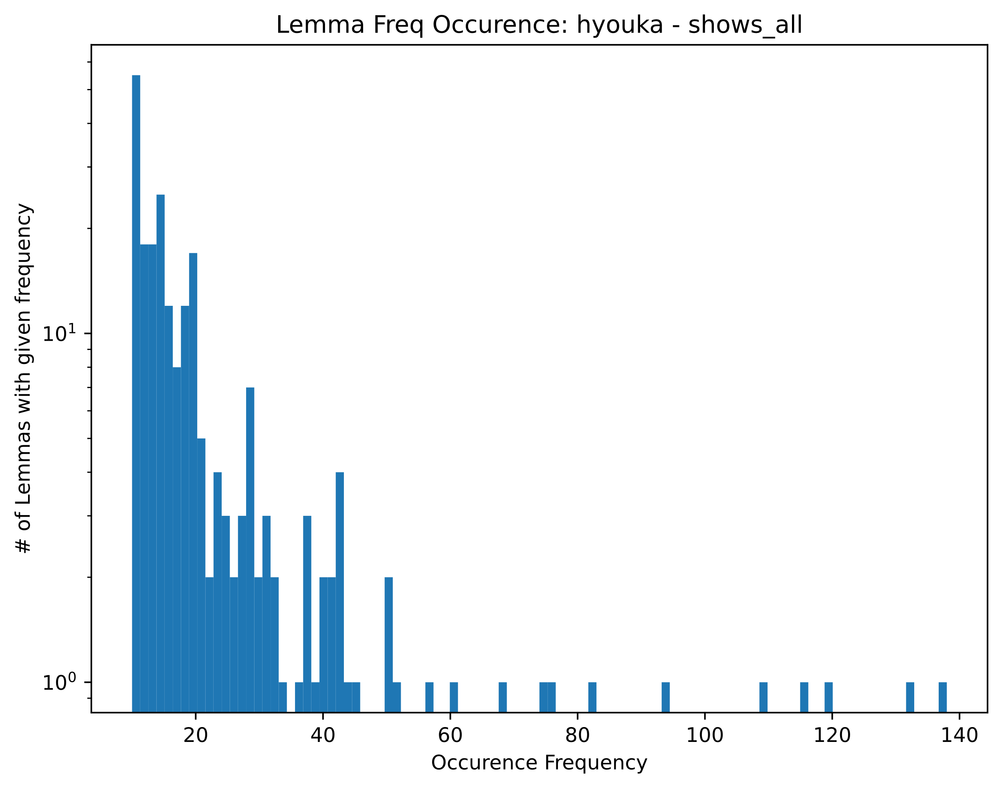
Hyouka show total and with removing ‘core-vocab’
For occurrence freq > 10

Slide 11
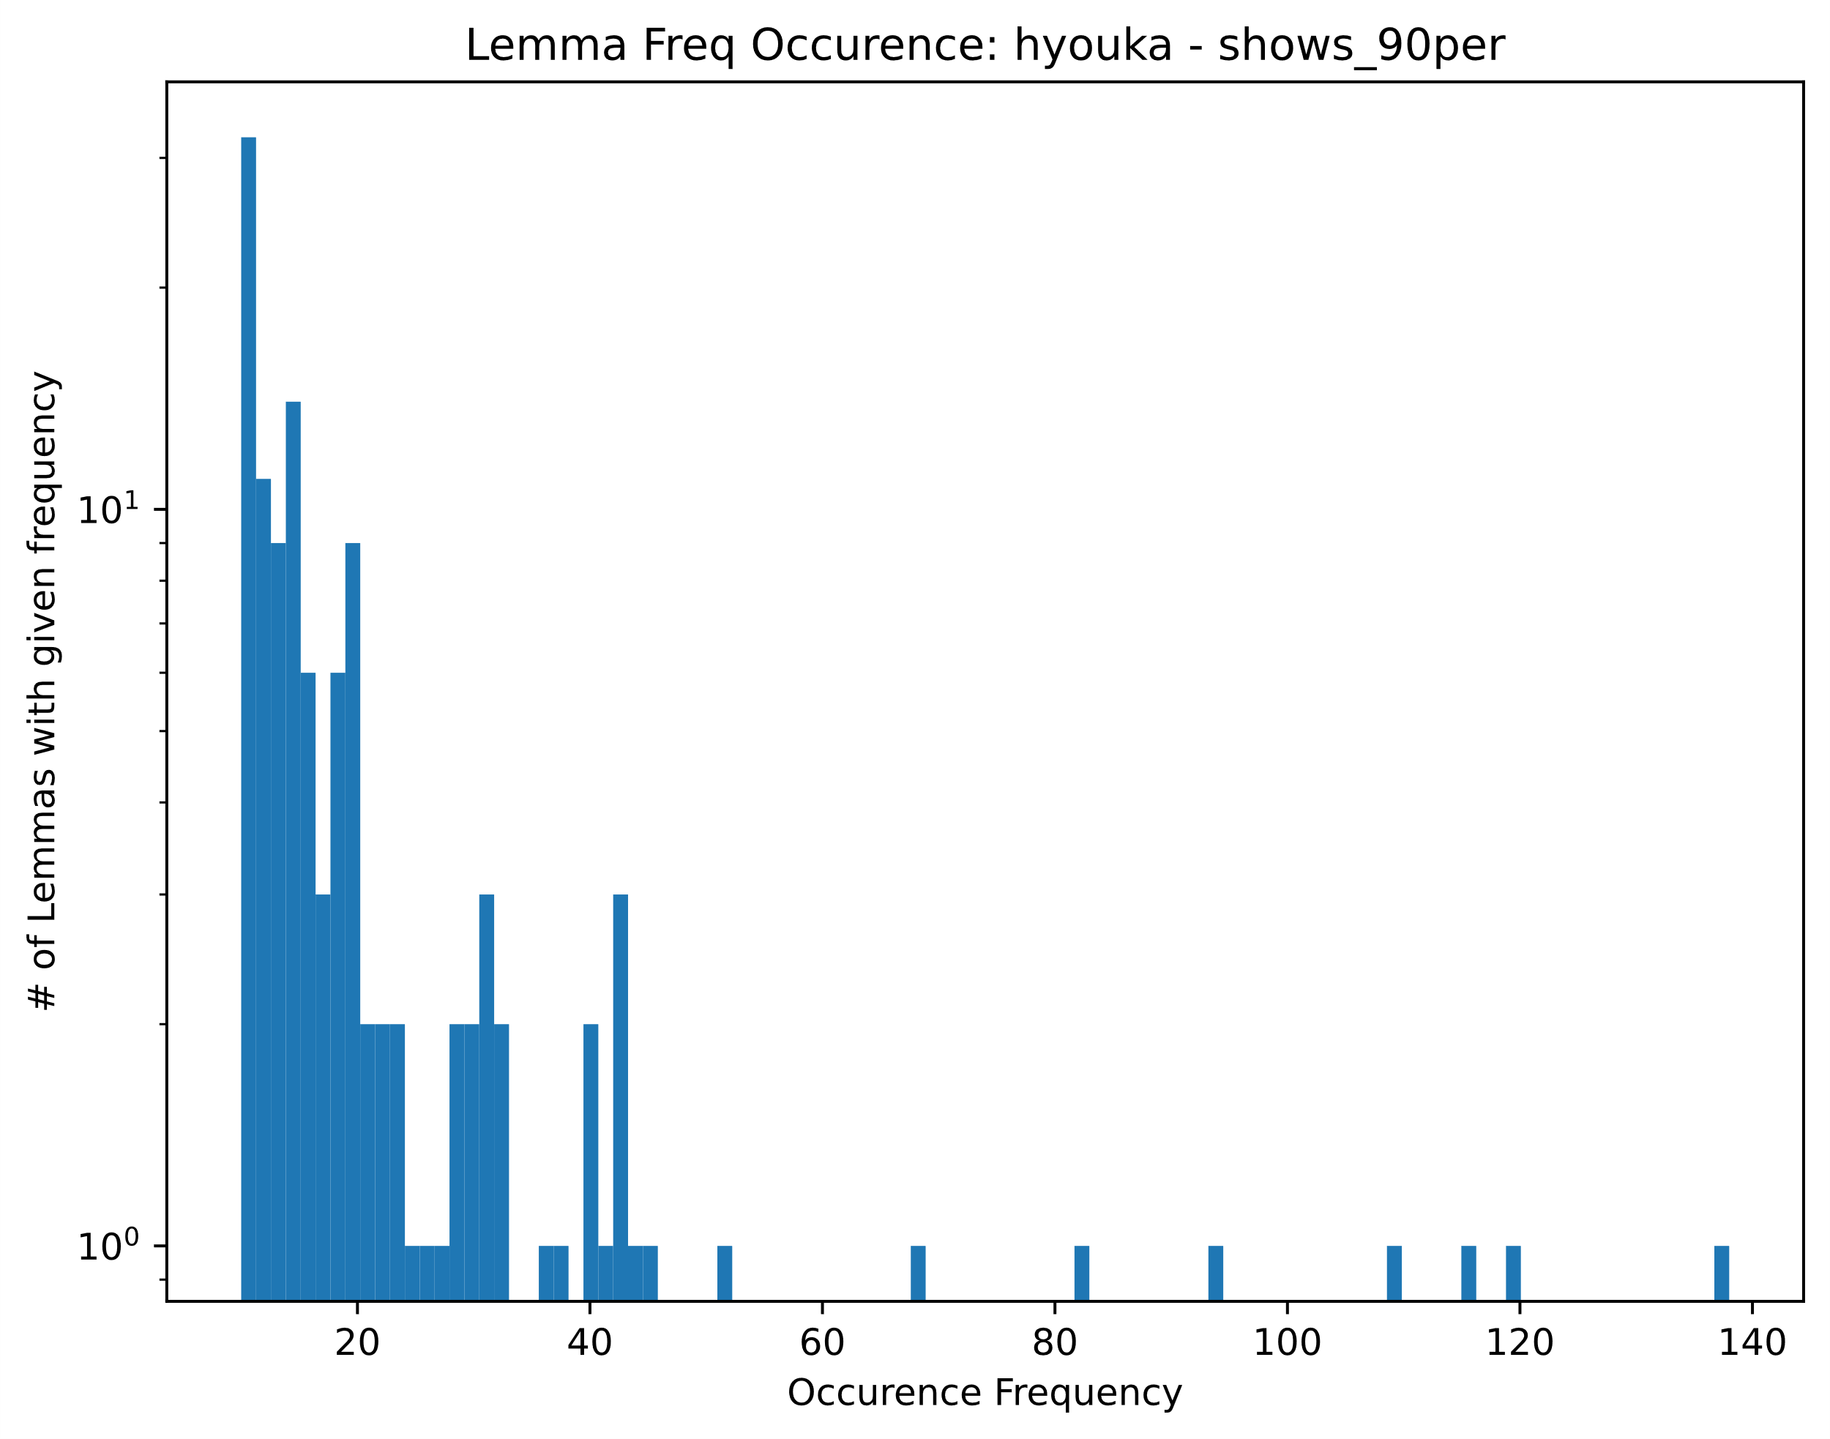
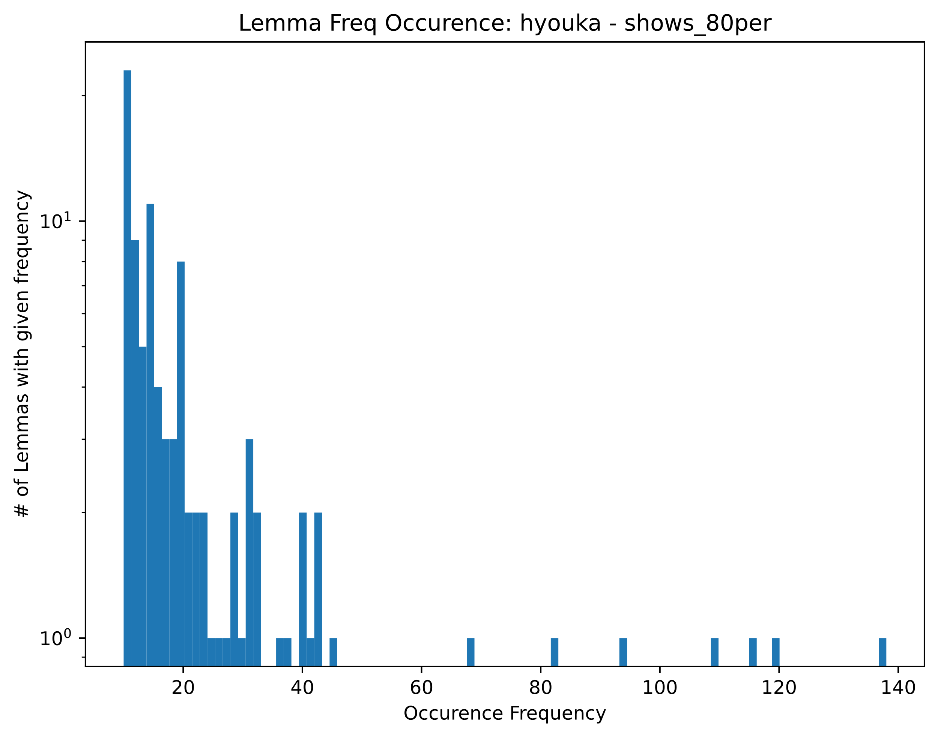
For occurrence freq > 10

Slide 12
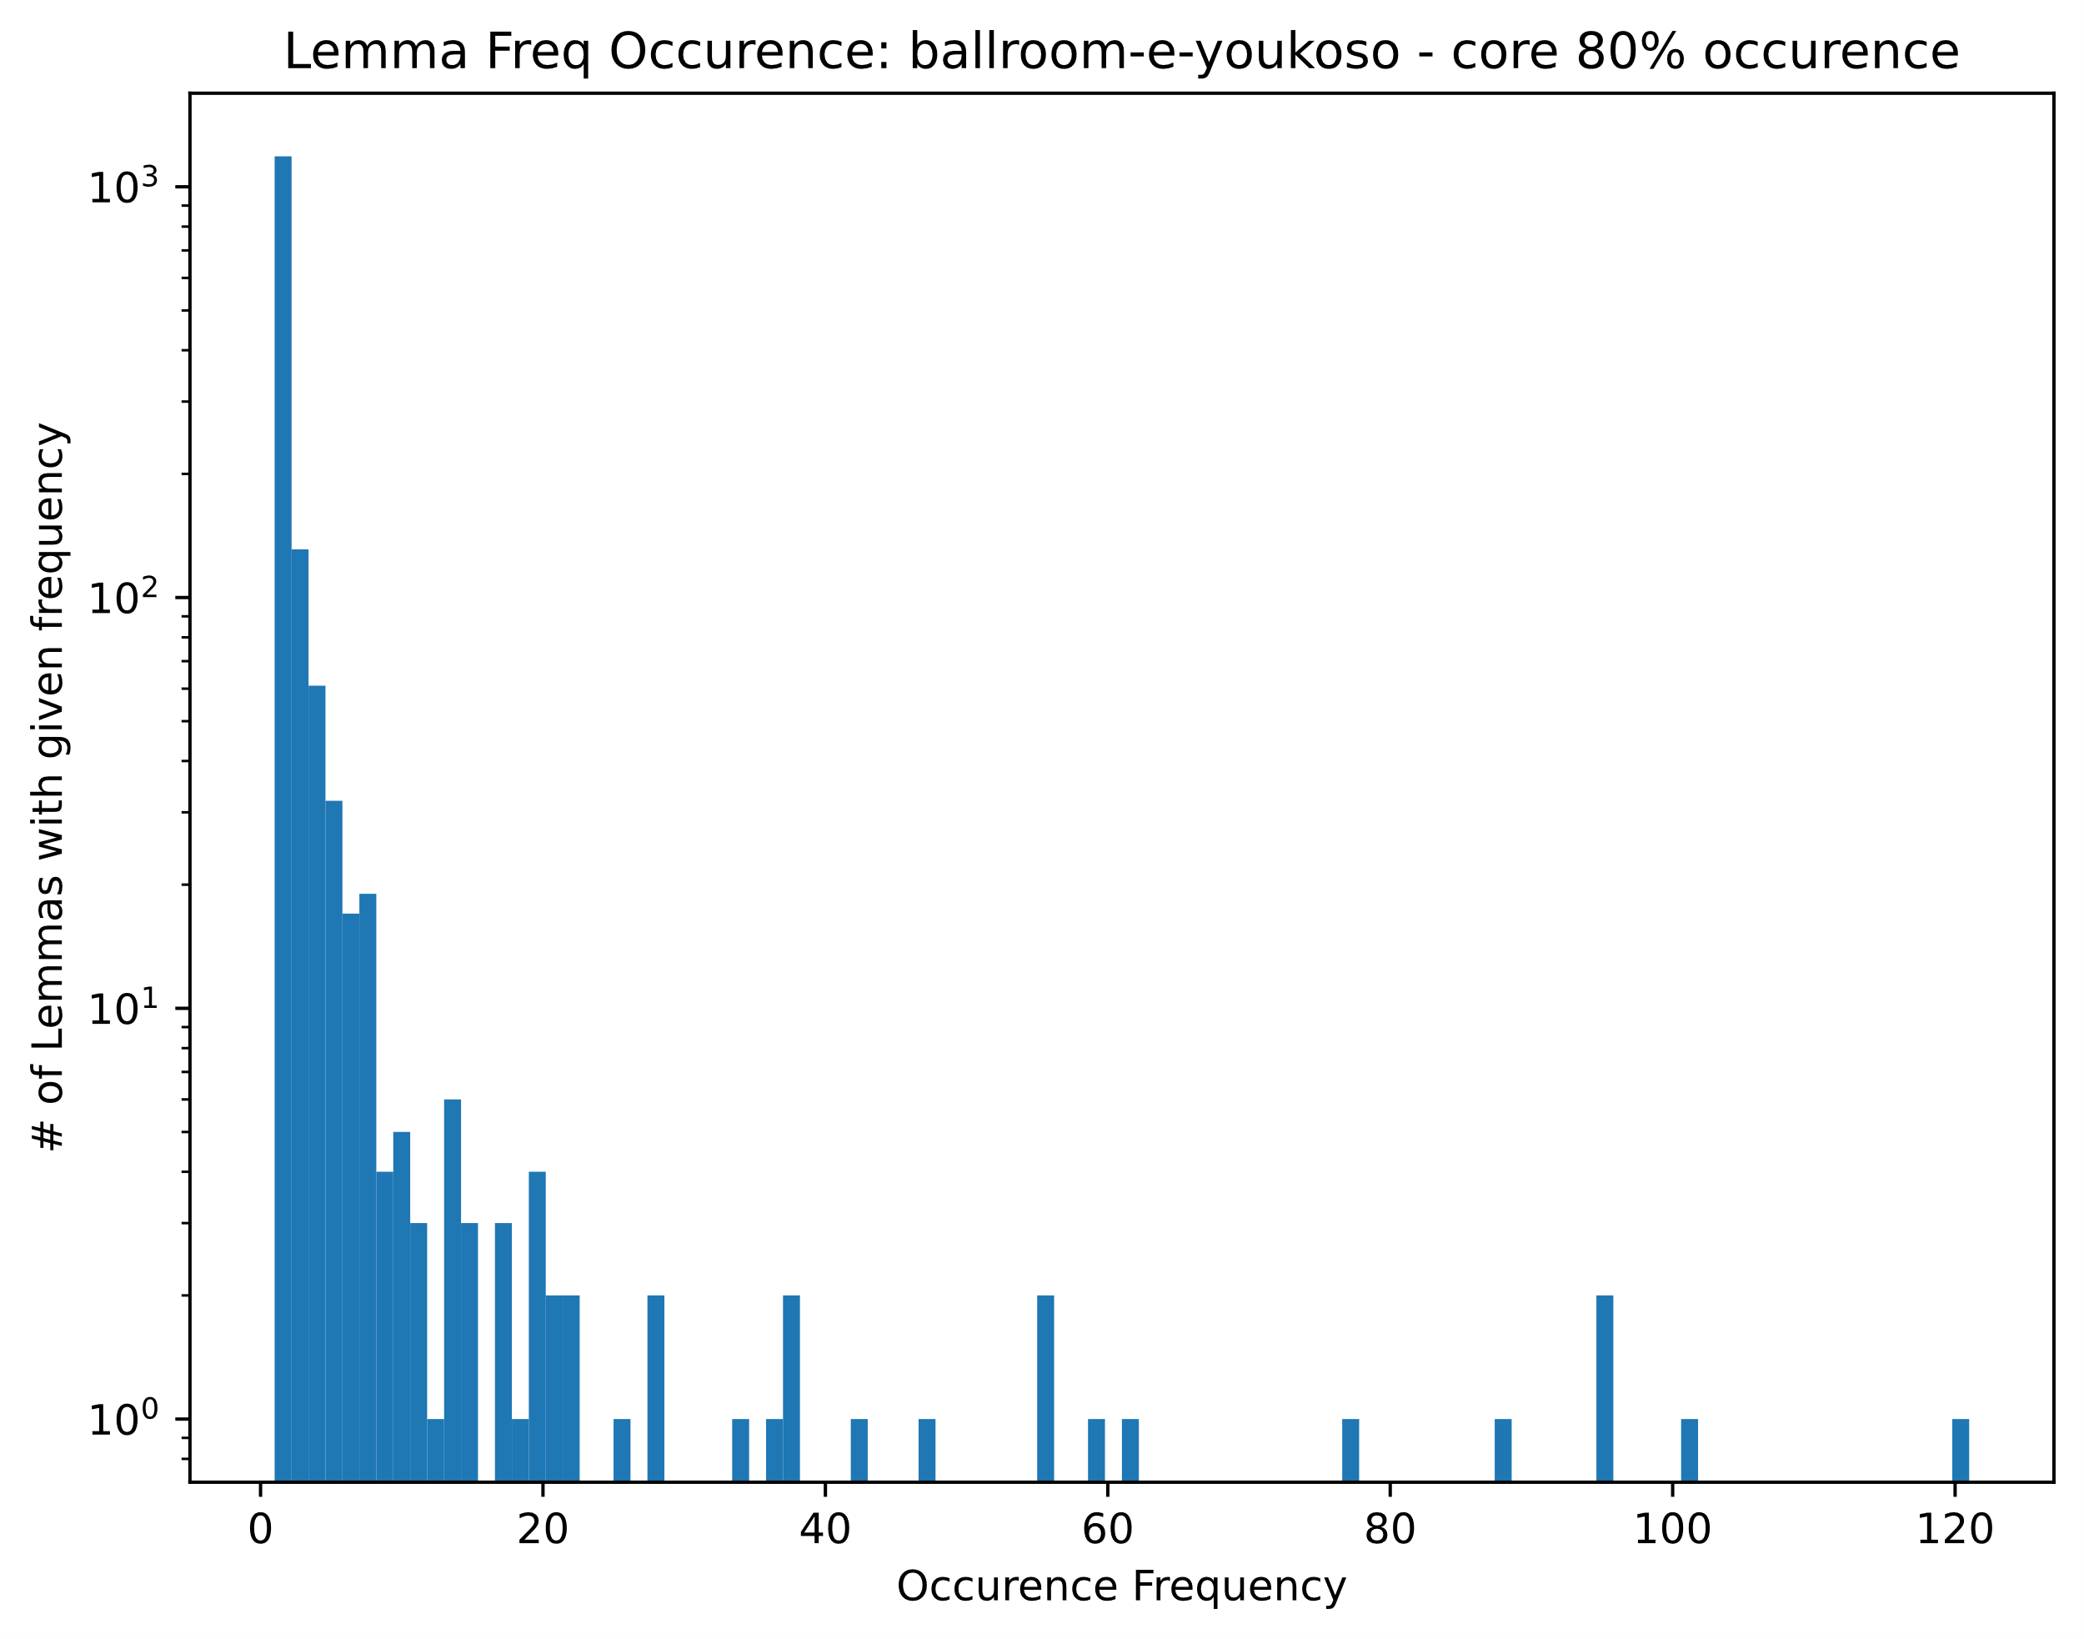
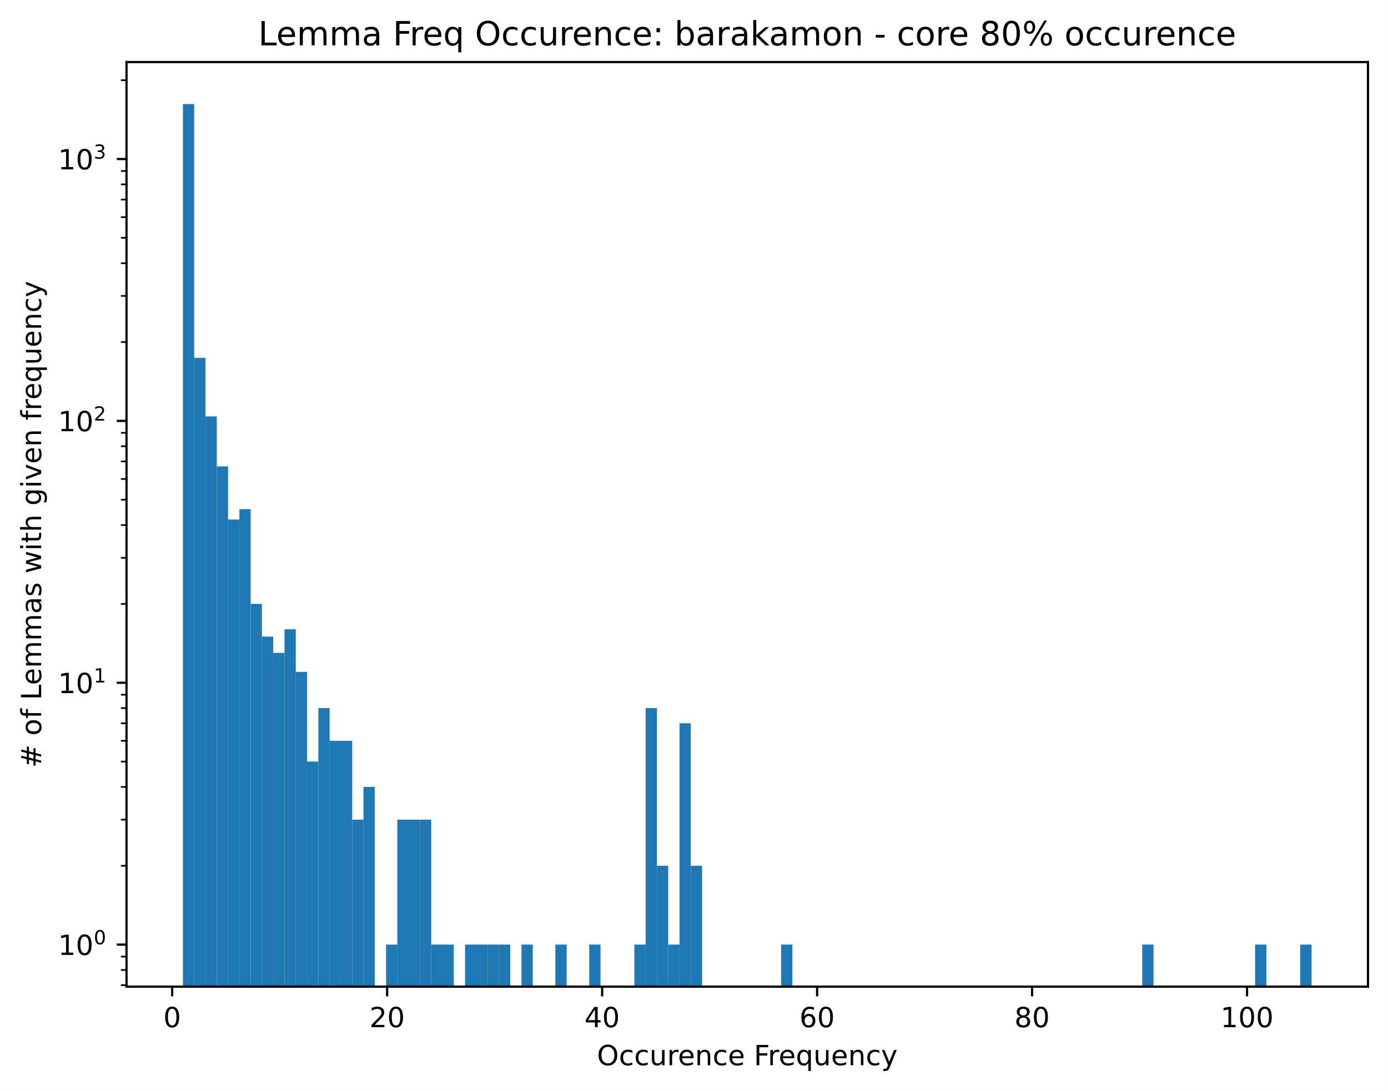
Example show histograms with 80% core removed
Which area can be considered the ‘domain’ vocabulary?
Setting division at an occurrence freq of 10
Where does the ‘domain’ vocabulary live? Set of words which capture the main contextual area of the language using throughout the show

Slide 13
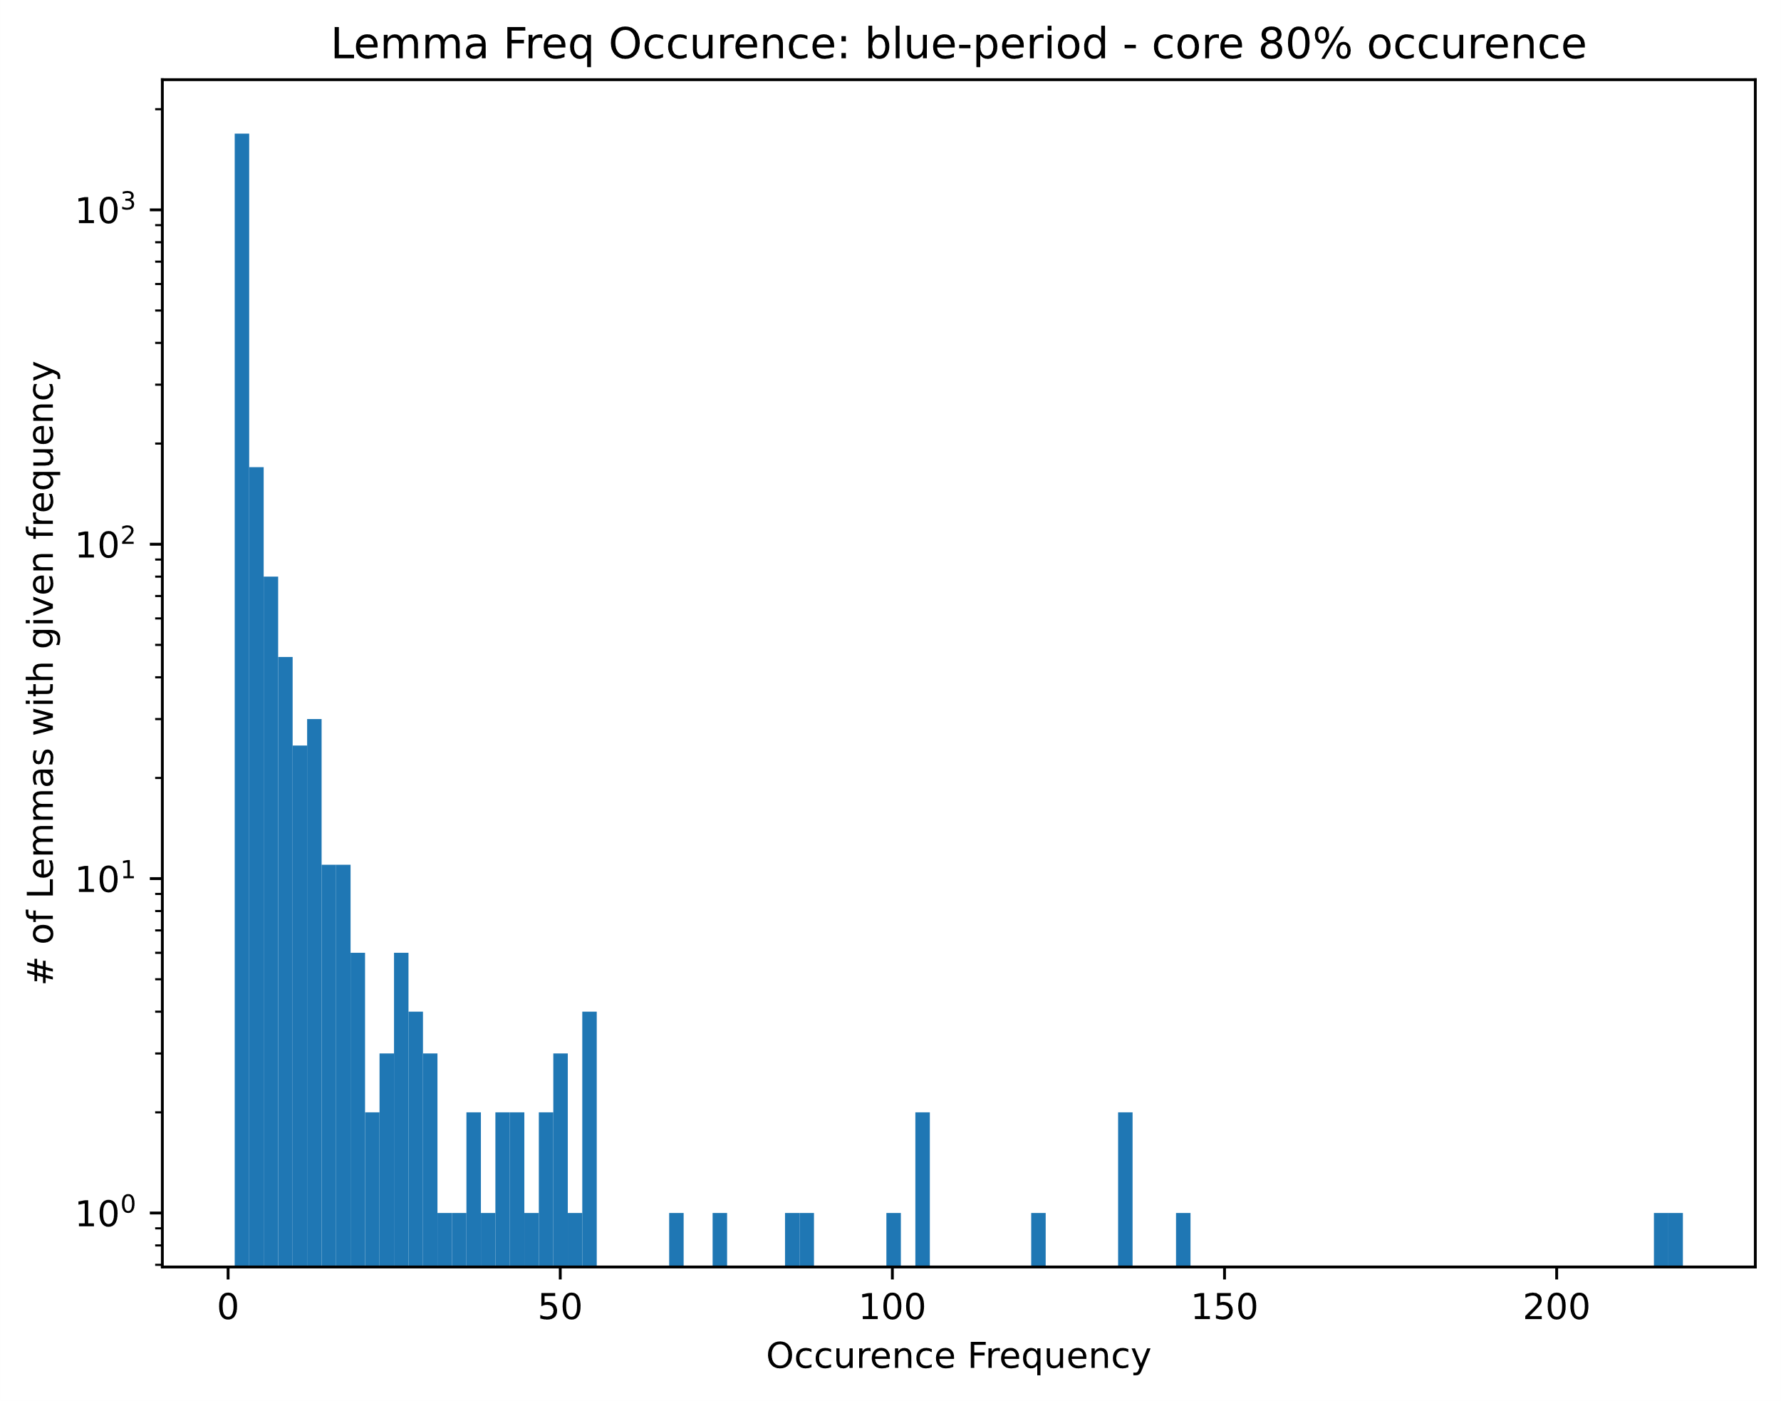
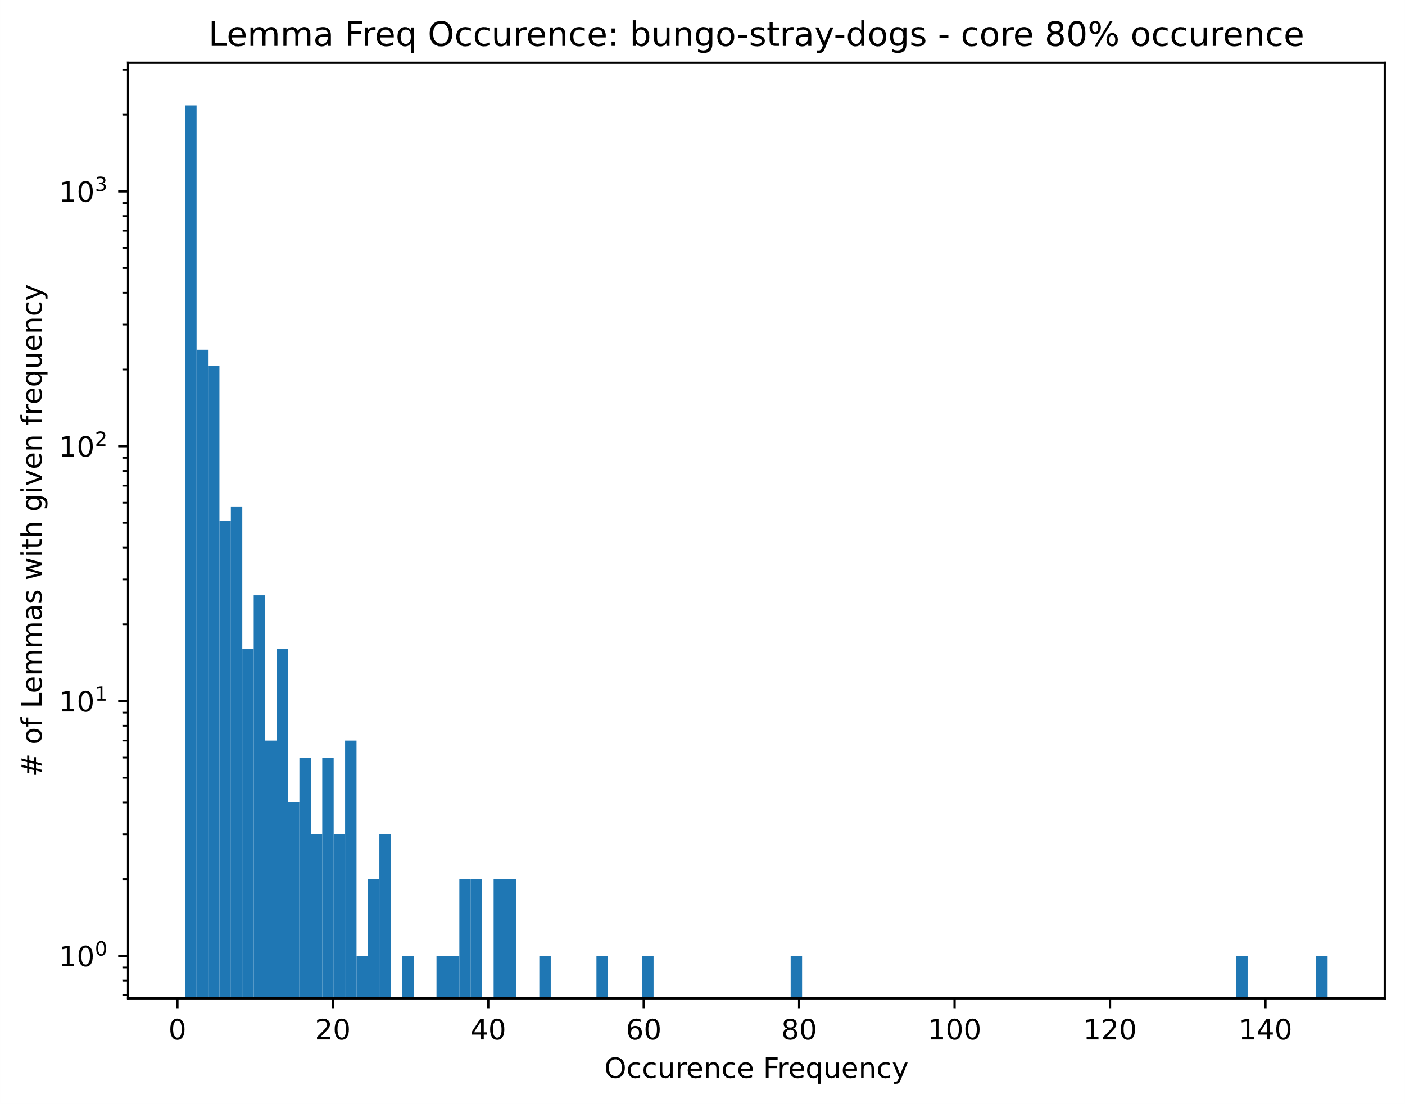

Slide 14

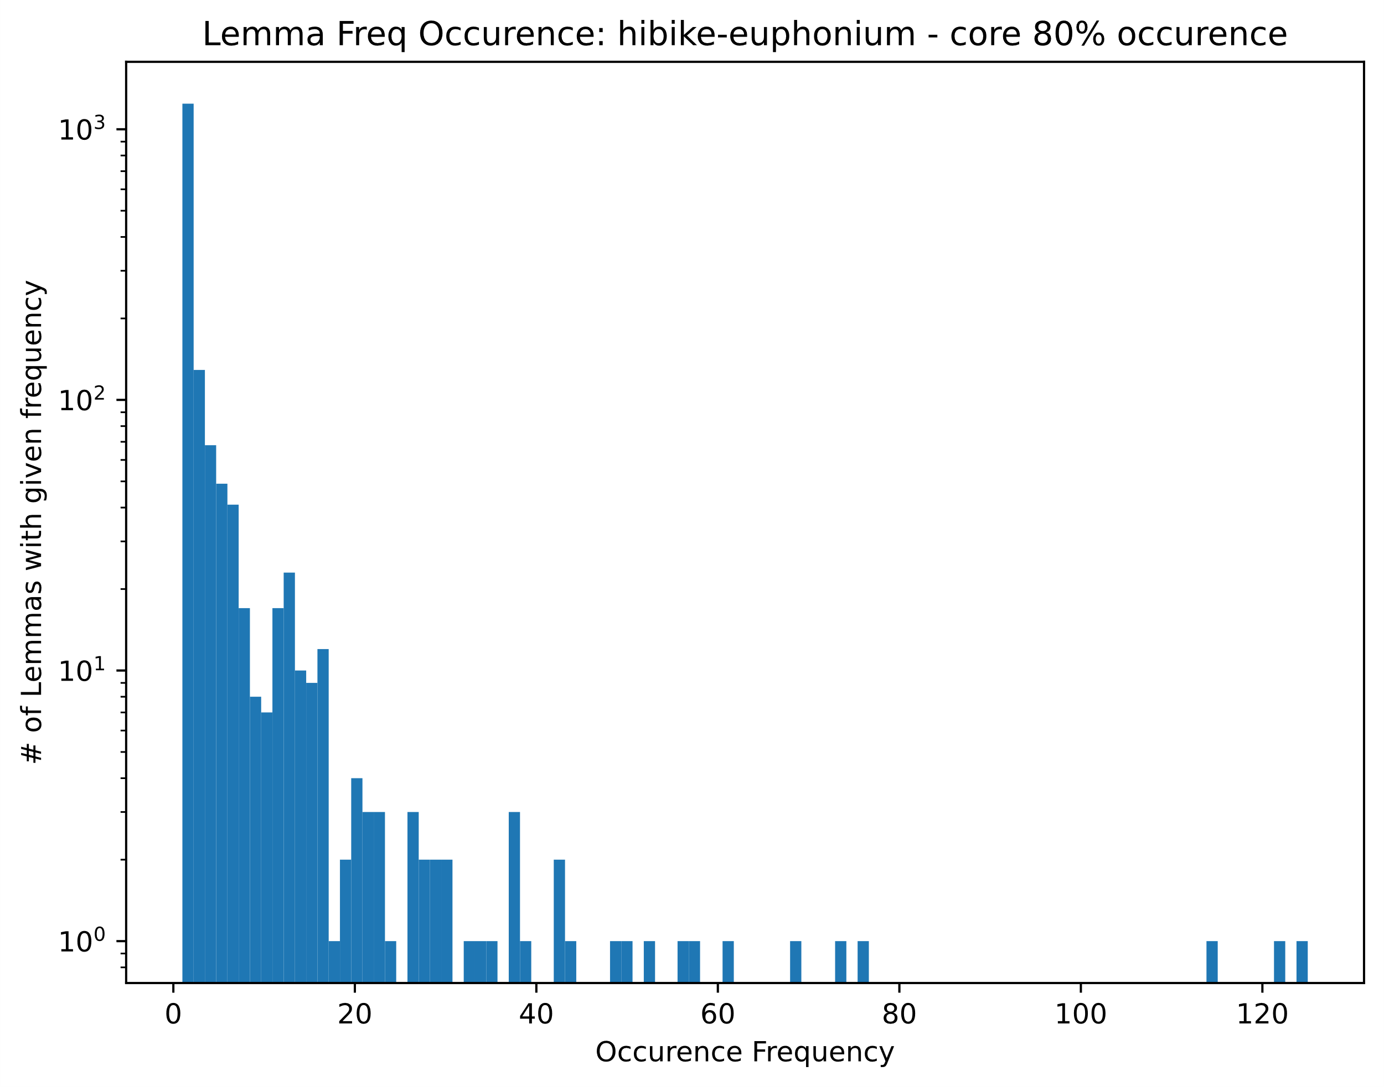

Slide 15
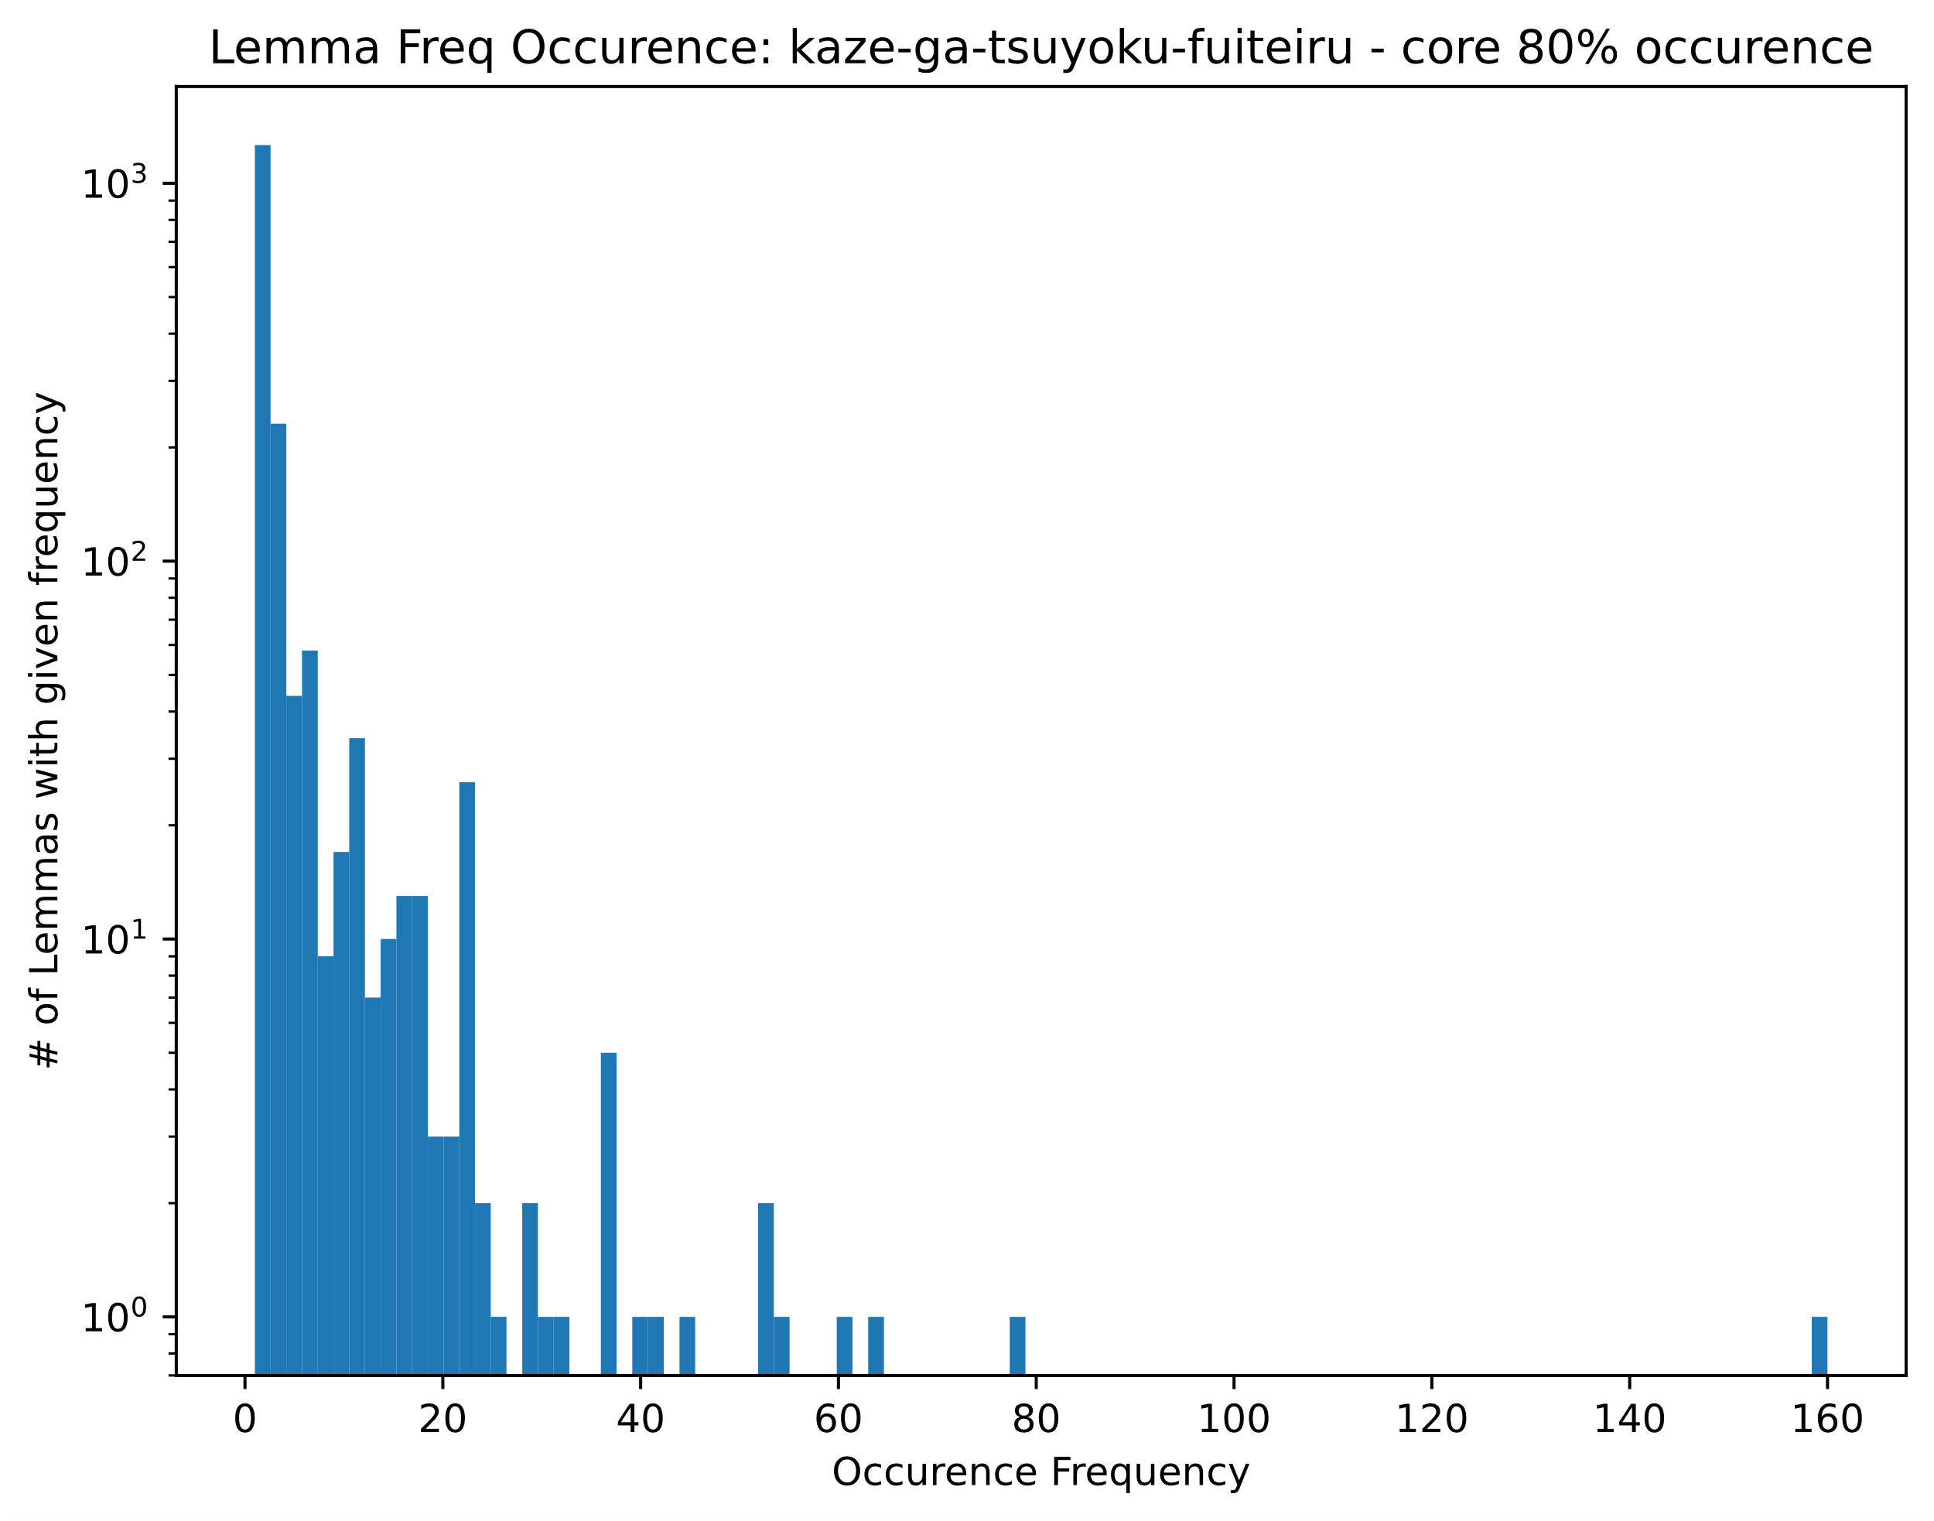
Initially, consider the words which occur more often than the determined minimum limit as the ‘domain’

